Slide 1
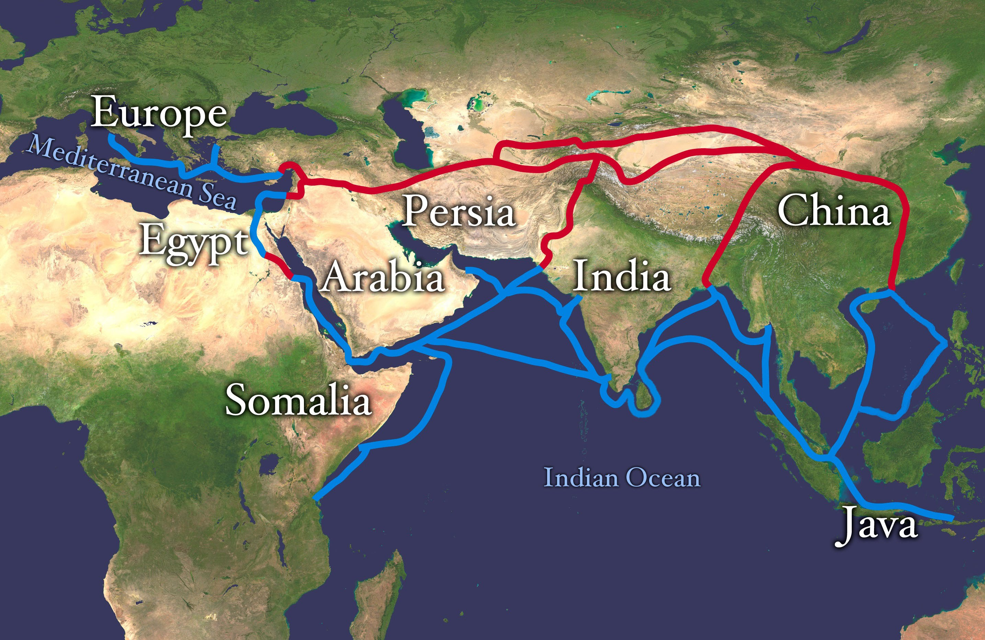

Final Project MGMT – 56100(Logistics)
Cotton transportation from
India to Europe

Slide 2

Team Introduction
Gaurav Sable
Keyur Nandu
Tharunkumar
Chandirasekan
Tejashree Shendge
Neha Priya

Slide 3



Why cotton?
Successful cotton production
Benefits from multi-component crop production
Support from government

Slide 4
Transportation requirement for cotton
Sr. No. | Requirements | Parameters
1. | Transit | Cotton bale dimensions and capacities
 |  | Moisture levels and environmental control
 |  | Risk of excess moisture
 |  | Mitigation measures
2. | Packing and securing | Packing cotton bales
 |  | Securing in containers
3. | Documentation and regulation | Export document
 |  | Shipping document
 |  | Import compliance
4. | Risk and quality assurance | Potential risks
 |  | Quality control measures

Slide 5

Cotton Process Flow
Preparation
Container loading
Shipping
Custom clearance at destination
Delivery to consignee

Slide 6
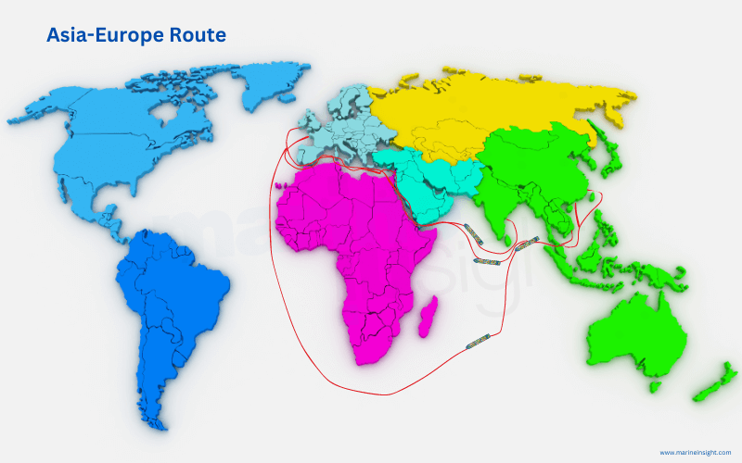
Current Routes
Route 1: Asia-Europe Route
Important trade artery linking Asia’s bustling commercial hubs
offers a shortcut for ships between the Mediterranean and the Red Seas
Over a billion tonnes of cargo pass through this route annually
If blocked or closed, then long detour around the southern tip of Africa

Slide 7
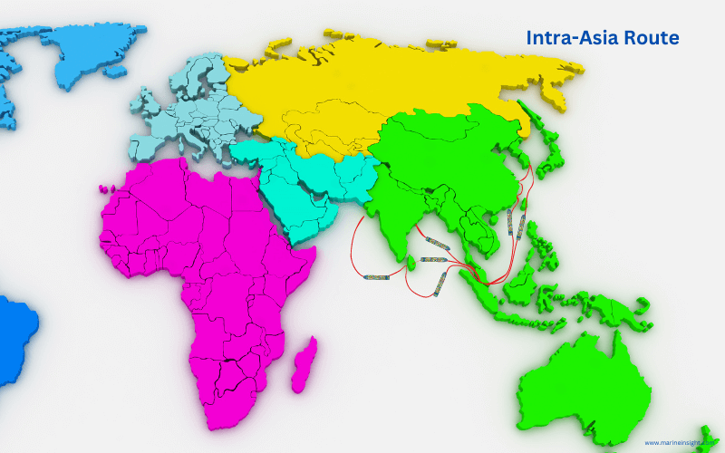
Current Routes.. Contd…
Route 2: Intra-Asia Route
Covering the Asia-Pacific region, this route connects ports in East Asia
Connectivity with major waterways
Challenge of port congestion
Interconnectedness of the Asia-Pacific region.

Slide 8

Current Routes… contd..
Route 3: Asia-Middle East Route
A direct maritime lane between Asia and the Middle East involves sailing across the Arabian Sea
The Indian Ocean also connects Asian ports and the Middle East.

Slide 9
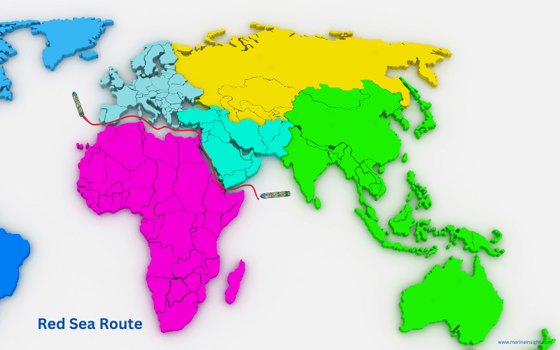
Current Routes… contd..
Route 4: Red sea Route
lies between Africa’s northeast coast and the Arabian Peninsula.
shipping cargo from Europe and the Mediterranean region to Asia, bypassing the Suez Canal when needed
The Bab el-Mandeb is a strategic maritime checkpoint
Important route for ships sailing between the Red Sea and the Indian Ocean

Slide 10
Challenges with the current routes
Sl. No. | Routes | Challenges
1. | Asia-Europe Route | Suez Canal Dependency
 |  | Geopolitical conflicts
 |  | Delay and detours
2. | Intra-Asia Route | Port congestions
 |  | Environmental marine concerns
 |  | Trade disparities and geopolitical risks
3. | Asia Middle East | Strait of Hormuz Vulnerability
 |  | Geopolitical instability and delays
 |  | Cost
4. | Red sea Route | Bab el-Mandeb Risks:
 |  | Energy Supply Disruptions
 |  | Gulf of Aden Challenges
 |  | Security Costs

Slide 11
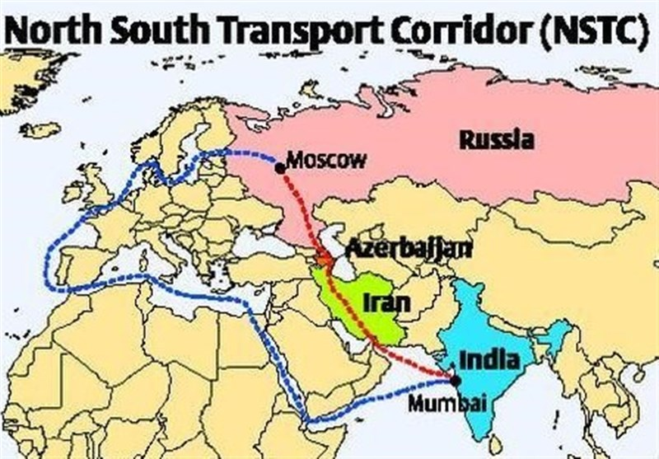
Proposed Alternative Route 1
INSTC Route (International North-South Transport Corridor ) The development of the INSTC offers a promising alternative, potentially reducing transit times to around 25 days.
Option 1: Gujarat → Chabahar → Tehran → Bandar Anzali → Makhachkala → Novorossiysk → Southern Europe
Option 2: Gujarat → Chabahar → Tehran → Bandar Anzali → Astrakhan → Moscow → St. Petersburg → Northern Europe
Option 3: Gujarat → Chabahar → Tehran → Astara → Moscow → St. Petersburg → Northern Europe

Slide 12
Cost Analysis – INSTC Route
Route | Plan | Estimated Cost (USD) | Transit Time (Days) | Comments
Option 1 | Gujarat → Chabahar → Tehran → Bandar Anzali → Makhachkala → Novorossiysk → Southern Europe | $5,500–$7,900 | 20–25 | Cost-efficient uses existing infrastructure involves multiple handling points, causing delays
Option 2 | Gujarat → Chabahar → Tehran → Bandar Anzali → Astrakhan → Moscow → St. Petersburg → Northern Europe | $7,400–$10,300 | 20–25 | Enhances connectivity to Northern Europe via the Baltic Sea efficient Russian railways more expensive and depends on Russian infrastructure
Option 3 | Gujarat → Chabahar → Tehran → Astara → Moscow → St. Petersburg → Northern Europe | $7,800–$10,600 | 22–26 | planned direct rail route through Astara aims to reduce reliance on Caspian Sea freight depends on future infrastructure development faces geopolitical risks.

Slide 13
Advantages and Disadvantages of INSTC Route
Routes | Advantages | Disadvantages
Option 1: Gujarat → Chabahar → Tehran → Bandar Anzali → Makhachkala → Novorossiysk → Southern Europe | - Balanced cost and transit time - low overland transport costs - Robust infrastructure | Multiple transshipments Dependency on Black Sea ports
Option 2: Gujarat → Chabahar → Tehran → Bandar Anzali → Astrakhan → Moscow → St. Petersburg → Northern Europe | Efficient rail transport Longer Caspian Sea leg lowers Iranian overland costs. | - Higher costs from rail transport in Russia. - Longer distance than Route 1, raising costs and transit times.
Option 3: Gujarat → Chabahar → Tehran → Astara → Moscow → St. Petersburg → Northern Europe | - Direct rail link cuts transshipment delays. - Shorter overland route in Iran. - Reduces dependence on Caspian Sea freight. - Potential for lower costs with new rail infrastructure. | - Rail Infrastructure initiatives - Higher costs due to long overland segment (~2,600 km). - Geopolitical risks (Azerbaijan-Armenia tensions) may disrupt transit. - Longer transit time compared to Route 1.

Slide 14
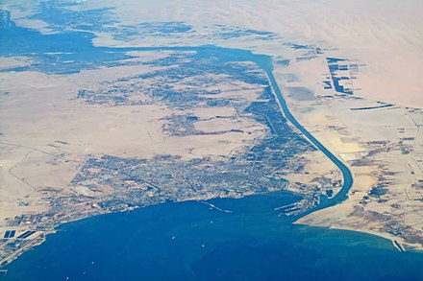
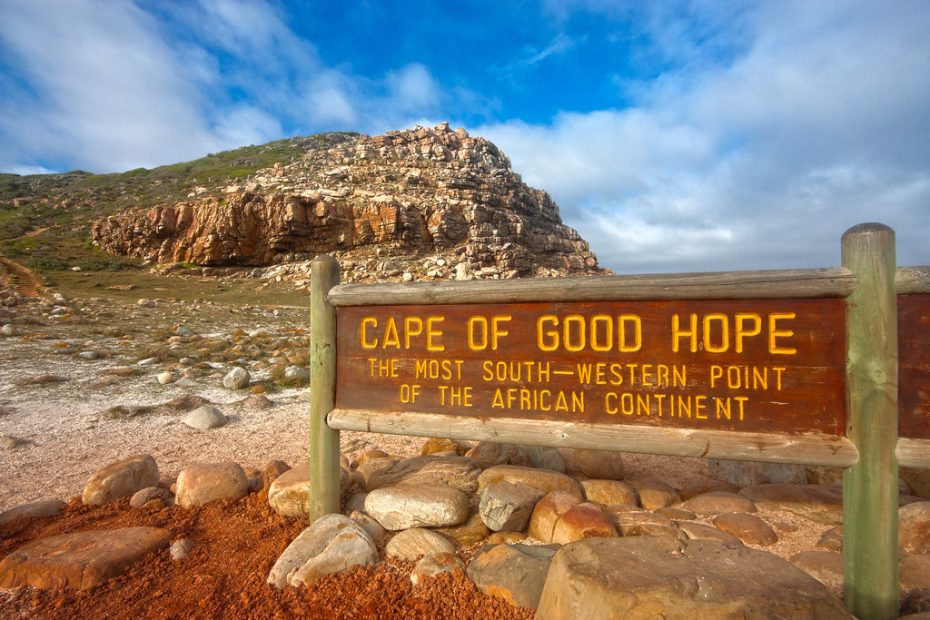
Proposed Alternative Route 2
Ocean Freight Transportation of Cotton from Gujarat to Greece through 1. Suez Canal 2. Cape of Good Hope

Slide 15
Route 2 – Cost Analysis
Cost Component | Suez Canal (USD) | Cape of Good Hope (USD)
Fuel | $1,056,000 | $1,920,000
Canal Fees | $150,000 | $0
Port Handling | $500,000 | $500,000
Customs & Tariffs | $1,500,000 | $1,500,000
Total Cost | $3,206,000 | $3,920,000

Slide 16
Key considerations
Lead Time – Reduction by 15-20 days through Suez Canal route
Environmental Impact: The Cape of Good Hope route consumes 1,440 more metric tons of fuel
Risk Factors: Weather and geopolitical risks through both routes

Slide 17

Conclusion
As per the detailed cost and risk analysis, we can conclude that-
1. The Suez Canal route offers a lower total cost and faster delivery despite the canal fees.
2. The Cape of Good Hope route may be suitable during geopolitical disruptions or high congestion in the Suez Canal.

Slide 18

Thank you!!!
Questions?

